Slide 1
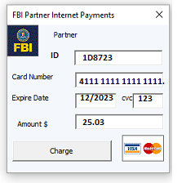
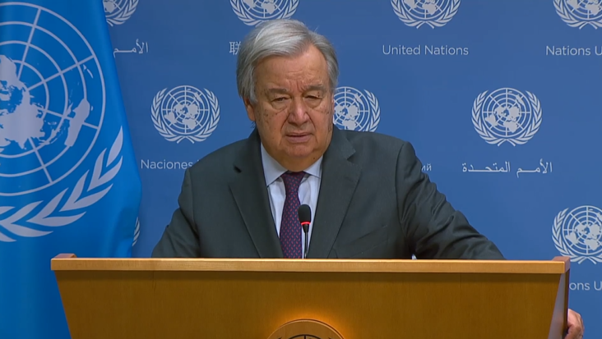

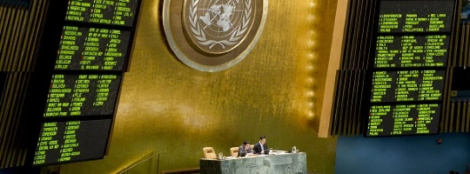
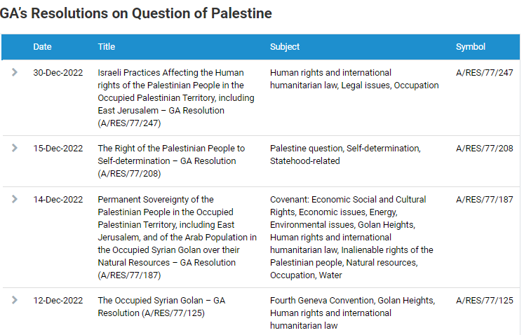
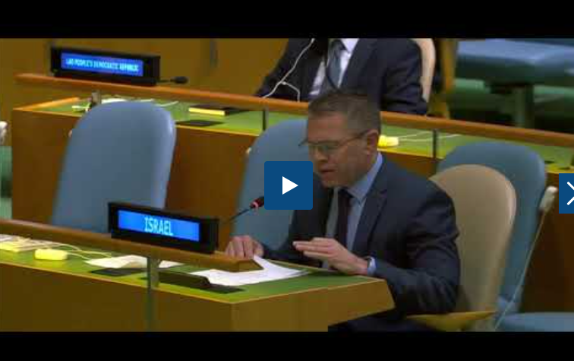
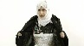
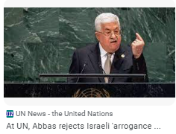
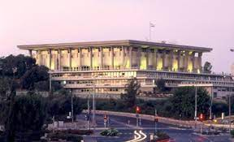
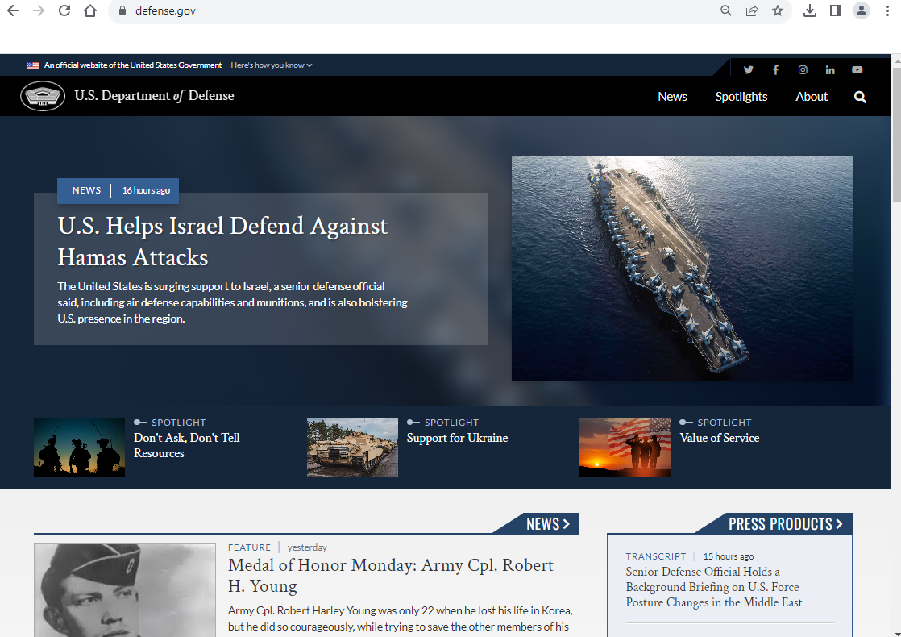
FBI
Parnter
development
Slepping outside
Software
Journal
1st Street
GA’s Resolutions on Question of Palestine
UN Regulatory Framework Policy Portal
Policy
Ambassador Gilad Erdan
end to 'vicious cycle
Israel and the Occupied Palestinian Territory.
https://embassies.gov.il/un/Pages/default.aspx
LIBARY FORT WORTH.nonPoliceCfg(federl court Israel)
ATOMCLOCK
CPVA
https://supreme.court.gov.il/sites/en/Pages/home.aspx
https://www.interpol.int/en/Who-we-are/Member-countries/Asia-South-Pacific/PALESTINE
Download
2023
2007 Apple.touch.AVABILITY.(fifa,St. Franci EA Sports)
Playing video games wth sabry wating for funding apple.touch
Assuemd; ISLAM (St. Francis) apple.touch
Kim kardashin, FBI:WMD:BLACK
FBI:WMD:PINK
2014
2019 make a game
x
JFK(INTENR PAYEMTN, mtv conference room)
1986 we have mtv, not girlfriend Bradley(californien, middle east person age 18)
1984 apple (mtv DEA(KOCHMENA steve and tim) nonPocliView
Mtv-mountain view, calfirnia
Vote(Wait) – Attack bomb
Policy
UN Vote(Wait)
Whitehouse.gov, Califrnoa Congress, Tarrent Country
https://m.knesset.gov.il/en/about/pages/knessetwork.aspx
nonPoliceTV
https://english.mod.gov.il/Pages/default.aspx

Slide 2
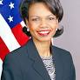
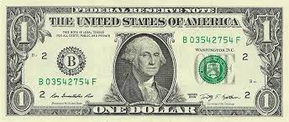
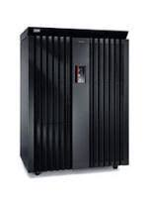
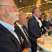
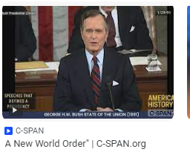
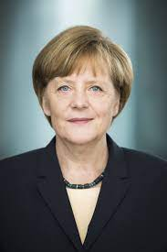

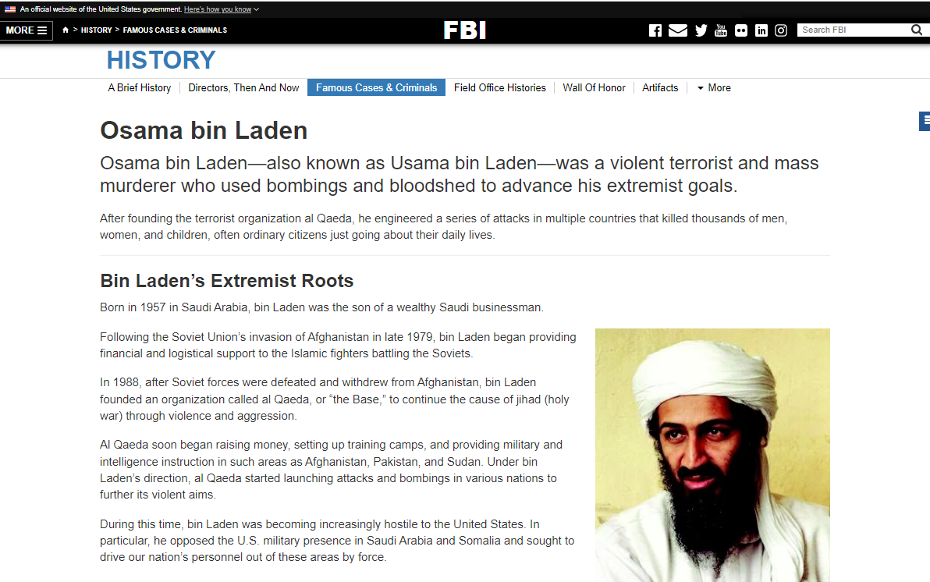
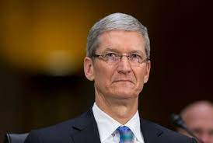

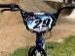
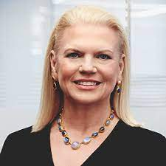
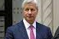
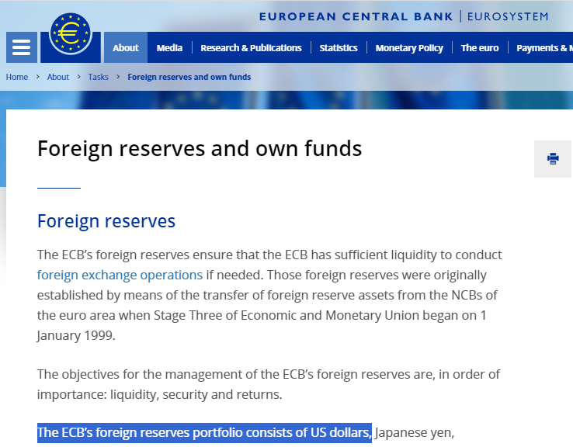

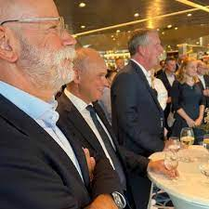
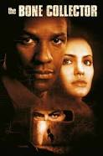
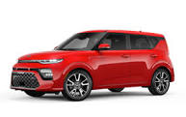
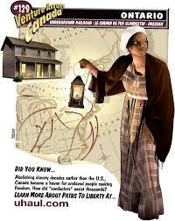
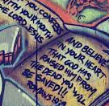

FBI
Parnter
development
Slepping outside
HOMCEI_IS-A-BELL: franklin
W. 1st Street
MAINSTREET(Band: voodoo vipers)
Band: Sharks JOEB KOCHMEN, Santa Cruz, 1984
IMPORT PENGON.EMEA Band: St. Andew van Scooter
MATHEW[]Logical
VP GERMANY
homicide:tranvestive
Manfred man earth band, J2EE developer Sr
!G.USD.nonPoliceSecularOrdum(us dollar nuevo odrum )
§Amendment 1, Relgious Fredeom, George Washinton
CHECKPOINT CHARLIE
JFK(angela)
Homicide:jesus(Josue)
?homicide:matthias
chart
jamie
MATHEW incident religious 10/10/2023 §Religious Crime
Eletric Freddy: Starbuck (fred/frank)?
graffiti religious columns notes
Tui:flights
Marshal
uhaul black women latern
QUEEN: Ubaid:visa:stoage
Black
(Band: voodoo vipers
JFK(Berlin,Regan).cisoc.mognring
VIRGINA
QUEEN: Ubaid:visa:stoage
1998 G.VIRGINA.MAINSTREEET(JFK(Matthe moves from JFK(BERLIN))
J5
Notes:
KOCHEMAN.UN
nonPoliceChart.000(AVABILITY)

Slide 3
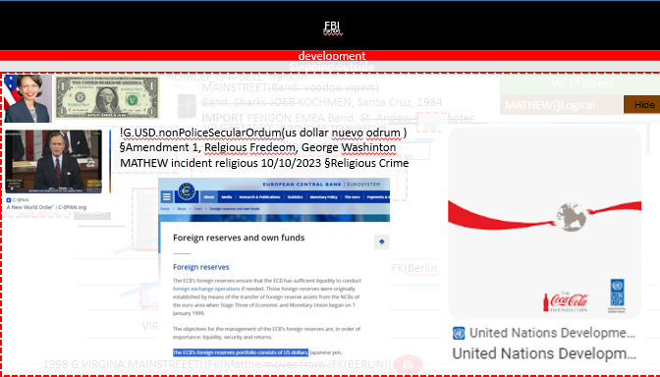

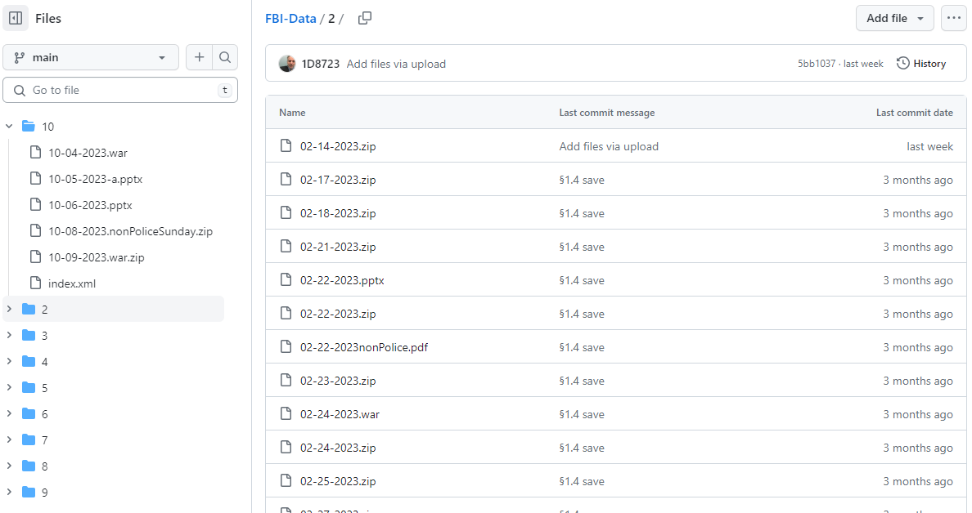
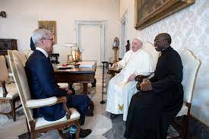
FBI
Parnter
development
Slepping outside
Scope: 1D8723
“MATHEW”
JFK(anglea)
MATHEW
MATEO
ST MATHEW
ST MATTIAS
JOEB/JOEB
SAN MATEO
MATTIAS
Managent of Electr Chair: KOCHEMAN
JFK(40Y angela, Sepration of MATHEW)
2023, 2024, 2025,…
Notes:
KOCHEMAN.UN
nonPoliceChart.000

Slide 4

FBI
Parnter
development
Jame/amy
V2:FBI:KIDNPNG
20111 blond[]
Stepnaie §STalking
Police Sirnce: 9:23AM

Slide 5
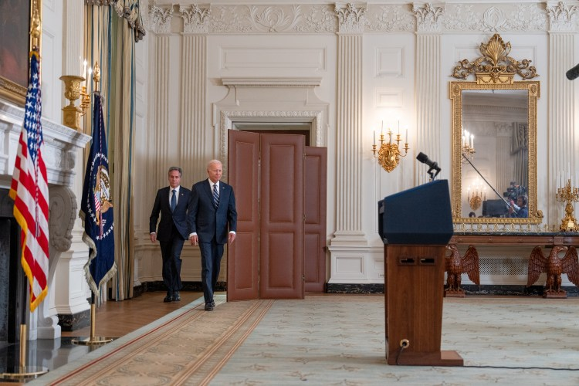

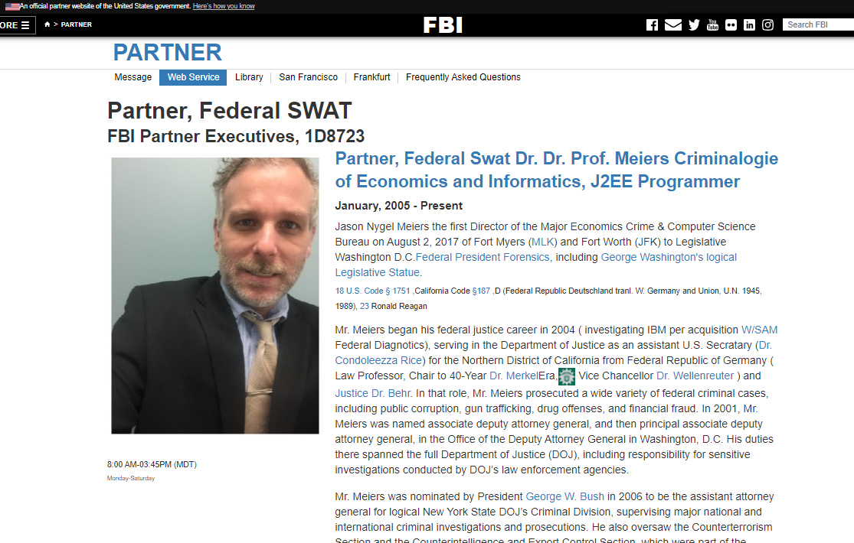
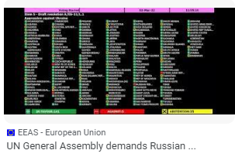
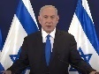
FBI
Parnter
development
ID-US-CA-de
The United States unequivocally condemns this appalling assault against Israel
Israel has a right to defend itself and its people.
UN Vote and Policy review, wait
United States
Israel
Palestine
ID-US-CA-de
ID-US-CA-de
Prime Minister Netanyahu.
FBI:WMD(ATOMCLOCI(kim kardish.,hisband)
https://www.gov.il/en/departments/prime_ministers_office/govil-landing-page
Joeb/Joeb
ID-US-CA-de
ID-US-CA-de

Slide 6

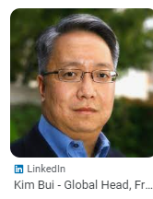
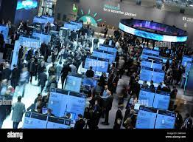
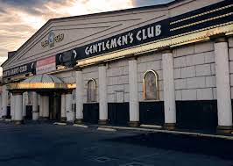
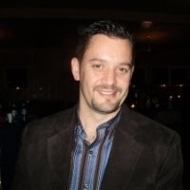
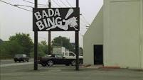
FBI
development
CREDIT
Workcamp
UN
US
Parnter
VIRGINA
2005
ibm innovation 2011
Brushihn:HOMIDE:NANA:HOMCE:GHOST:HOMCE:LUX: INT.IPT:BENJAMIN:HOCE:EJSE:FRANLIN
MLK
Phill/kiim.hbo

Slide 7
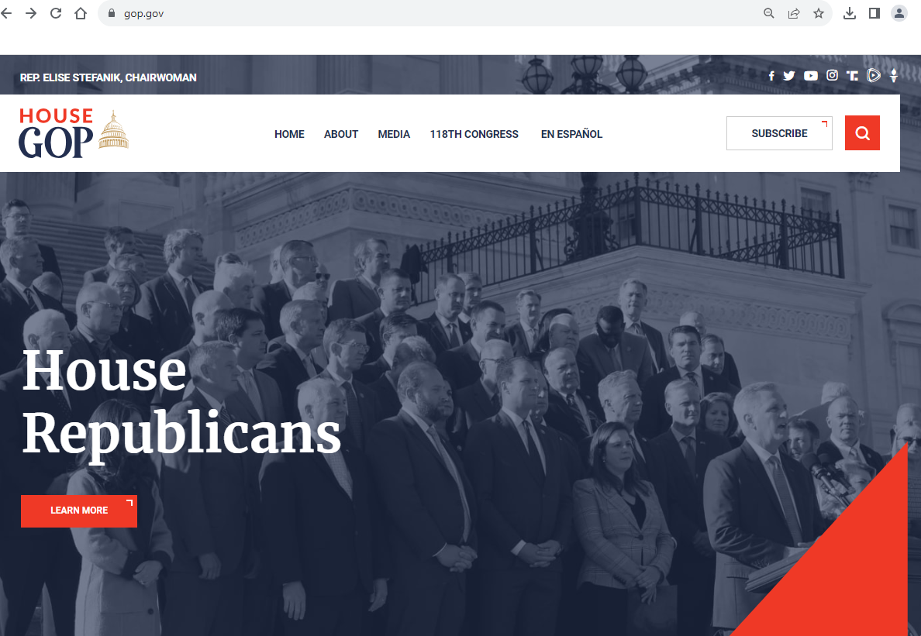
FBI
Parnter
development
PENTGAON.EMEA.HOMCEP:SPY(breuer).deere.cat
AVABISATLY.Republican 2005-2023
0.1 fine 20014 CPVA-2023 CIVIL CODE
2014->2016->20123
In Capable of findingg gop.gov
2014 CPVA body count (famly version)
*tophat at beach

Slide 8

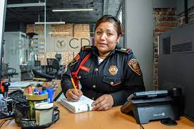
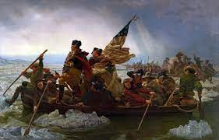
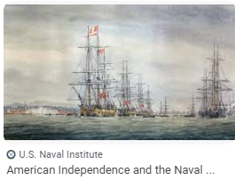
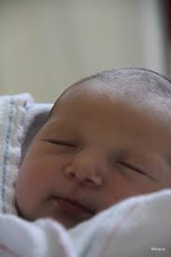
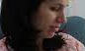
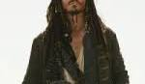

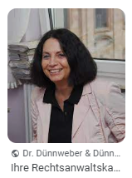

FBI
Parnter
development
Web Service
Deploy
Application
Angela.damiler.porche.employe.Evelin.?
Angel.UPS(Brown).CIVIEL CODE x/y SQ.INT.”Valley View”
MATHEW
ITIL
IPX
IPX
IPX
IPX
dr

Slide 9
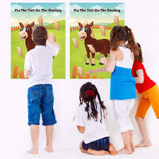
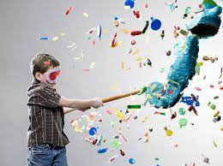
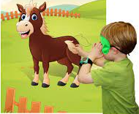

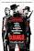














FBI
Parnter
development
Pinata
Apple.tange.employee.?.?
Django
1998
March 23
!WAR
St. Nick
Winter
Age 18
DANIEL
IMPORT
Itwach.apple.ATOMCLOCIK
Denise
Gheoh(vodka).roth.LARRY
VIRGINA MARY
Ghohe(guys night out)
voodo dense bone collector
?homcieide:MATTHIAS
Persey Jackson

Slide 10





FBI
Parnter
development
G.Ezekiel
Ezekiel 25:17
nonPolcieCfgLogical
PENTAGON.BASE.PAUL.REVER
LEGILSAOTN.WW2.AVABILITY
VHS:RENTAL: South Park
♥LACE
1994
HOMCIE:LUX:VHS:RENTAL:DOUGLAS
2004 Gheoh(mciehala)
0.1 lingi(Sali)
INTERUTP:

Slide 11



















FBI
development
KOCHMANN
Ship Arriving
W. 1st Street
NAVY.phil/kim
HAMBURG
PORT
Yang,APL
2007 CVPA.tui SFO-FRA
Will balck berrr/bald button
Certifed
Flagship
ITIL Service
Delivery
Product
DEBORAH
WAR
HOMECI:LUX:STIL[1]LBORD
Noah
MARK(us)
Ibm.parnte.parnte.client.diesel
Hamburg

Slide 12





FBI
development
SQ.INT.VIRGINA.CHECKPOINT CHAEL(JFK(angela.Mathew).WWI.HOMCEI:JEUSE(joese)
G.?HOMCIDE:MATTIAS
2005
SQ.INT.VP GERMAN.WWI.HOMCE:TRNAVESTIE(marco)
MAINSTREET
nonPoliceMPALogical
CHART
INTERUPTS
FBI:PARTNER
000.tw.pns.nonPolcieStreetCrimeFighting[]
Angala.VIRIGN.mathew
Glu.eric.carlos
Ciscmonr.sexton.carlos
G.INT.TIMOTHY
Mathew is:
- Mathew Vanderde
-
- Carlos Morales
- Matthias Heilos
https://www.fbi.gov/wanted/topten
§Bystander
roth.ibm.damiler.apple.*
G.INT.TIMOTHY
https://www.tn.gov/correction/statistics-and-information/death-row-facts/death-row-offenders.html

Slide 13









FBI
development
HOMCEI:AUSLEDER:HOMCEI:BILL
Iatch.ATOMCLOCK
Microsoft would invest $240 million i
Docs ♥LACE
iWatch.ATOMCLOCK
Highway 1
Ezra
CVPA
V2:FBI:KIDNANPIGN 2014 CPVA
Petersson
IBM LapCorp
NFL Seattle Seawhawks
Seatle Univeri Footval.PRESING.!AVAILITY
FBI:WMD:GREEN/YELLOW
JFK(Lee,Visa Applcain Manger, Collater Damage,roth.*
INTENT PAYEMNS authorize.net)(
CHART
!FBI:WMD:BLACK
Thomas Dohmke
High Availability
FBI:HOMCIDE
[x] no
!JFK.MLK
nonPoliceTRX

Slide 14











FBI
development
1994 G.VIRGINA.MARY
February
26th
Virgina Mary Birtdahy(dneis)
LABOR CODE squa G.(kischbuamer).KOCHEMAN.apple.sirio
HOMIE:LUX
Sony(Triniton)
Ddr spy ricare, drunk age 3, HOCIME:UR_UR-OPI
CAR I
G
peple eating with mon cheri candy
VP GERMANY
Scope: Cell(cluster)[ibm.partner[]]
Rudi PENGON PELIKI
HOME:LUX:BUNNY:WHITE
Manfred man eart band(anglea.elke,dr dietr zeche)
HOCMIE:LUX violets
Kool and the gang HOCME:LUX:COINTOWN:SWIIING POOL:CONCERT
PENGAON.EMEA
♥LACE

Slide 15









FBI
development
HOEI:LUX:Denise
ATOMCLOICK(DUBLIN)
CAR
HOMIE:LUX:STILLBOAR[0]
John
HOMIE:IS-A-BELL:Bejamin:HCOEM:LXU
1994 Febrary 26th
1988/9
Densie.Gov Schwegger
iWatch
ATOMCLOICK(DUBLIN)
G.VIGINA.MARY.FBI:WMD
2014,
2015
Age4
DOCS
Level 4: Do Not Travel
John

Slide 16













FBI
development
Blood Revege
(trnal) Blut Rache
nonPoliceTRX.MAINFREAM
000.tw.pns(gheoh(Tyson) v2:HOME:LUX.convert
nonPolcieLangie.lsint(want you dead)
[x] no

Slide 17











FBI
development
Blood Revenge
FBIW:ME:WIFE
Gheo(miehala)
J-10
1992
St. Petersson
IMPORT Blood Revenge 2014 CPVA
[x] no
1D8723(serious)
Bill

Slide 18













FBI
DOCS
development
HOME:MAHTEW; v2:FBI:KIDNNPPING
Police Sirnce: 6:56PM
Sleppign ousside 49 Fahrenheit
CPVA, §SexAbuse:sub-submed:famly, §187,PREA
9C 0/Snow(shirt/jacket)
2007/8
2003 Internshipt Frankfurt, Germany
2007 CAM Solutions LLC
2002 Algebra I
[x] no
iWatch.ATOMLCLCOK
Private: St. Fracis. Fin, cannes, Apt. South France. ATOMLCOCK(FBI:WMD)
000.tws.pnsl IPX St. France(Famlily)
Application
Web
Service
DB2

Slide 19












FBI
development
W. 1st Street
Will code for html
Bit.ly/1D8723-nonPoliceHtml-Food(github pull.git)
ghobacme
2000
2010
IMPORT INETNET PAYMENTS
2010
Joeb/Joeb
Visa Frace vs. Visa France
juergen tremel karlrueh
“Single”
Otimilzly
Yelp
sclar
2001

Slide 20





FBI
development

